Slide 1
SPARK INSTALLATION

Slide 2
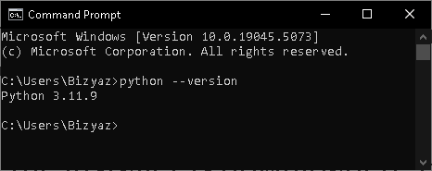
Step 1 : Install Python in local system
a. Download the latest version of python from:
https://www.python.org/downloads/
b. Once the installer is downloaded, double-click on the executable file (e.g., python-3.x.x.exe) to start the installation, make sure to check the box that says “Add Python to PATH” during installation.
c. Open a command prompt type python --version or python -V and press enter to check if Python is installed.

Slide 3
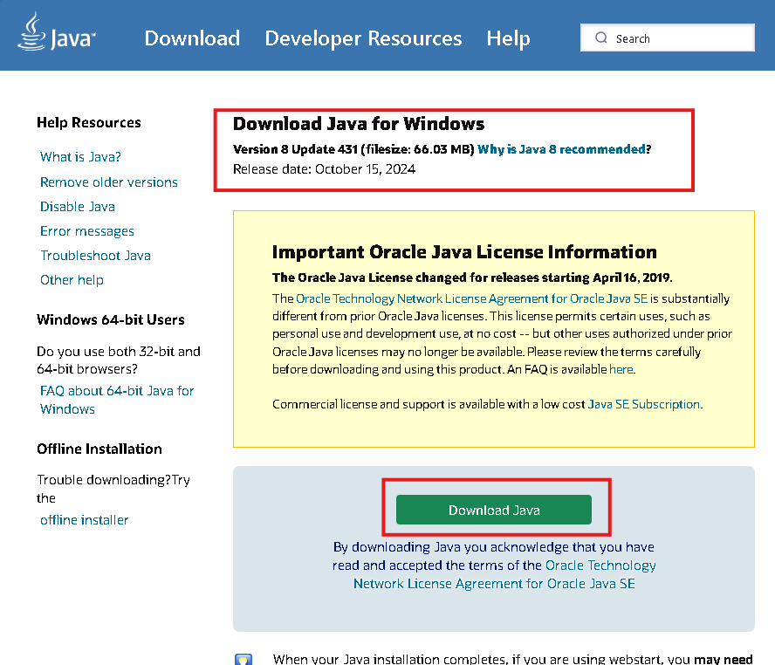
Step 2 : Install Java8
Visit the Java website and download it.
https://www.java.com/download/ie_manual.jsp

Slide 4
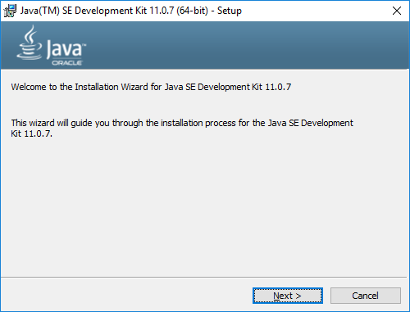
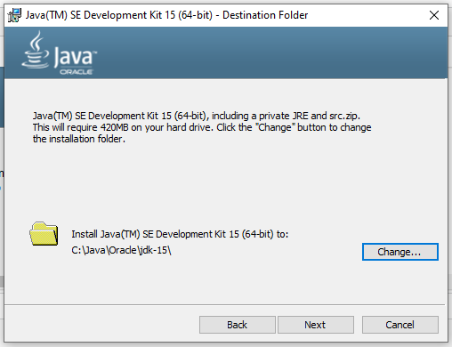
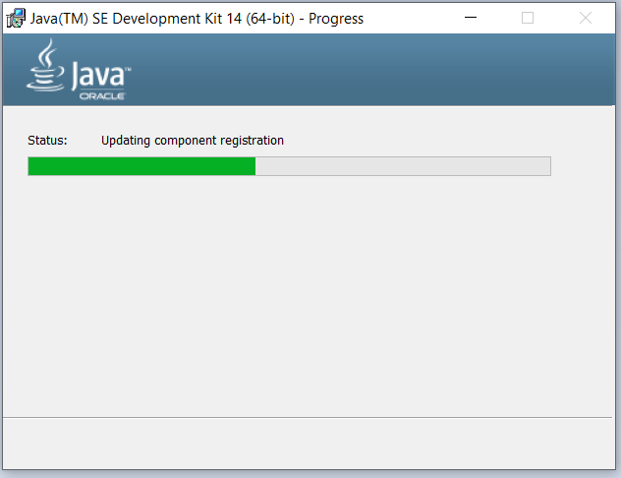
Installing Java
Run the downloaded JDK installer.
Follow the on-screen instructions to complete the installation.
Note the installation path (typically in C:\Program Files\Java\jdk[version]), as you’ll need this for environment configuration.

Slide 5
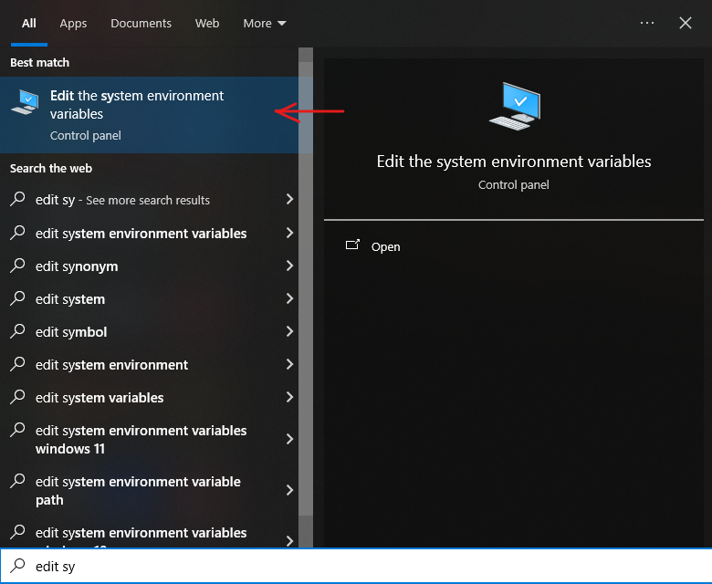
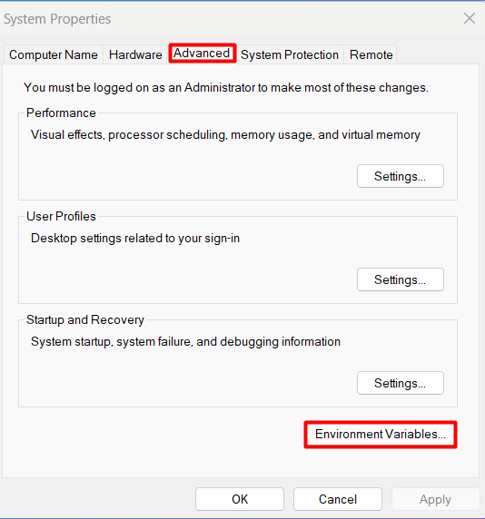
Setting Up Environment Variables
Open System Properties (you can search for “Environment Variables” in the Start menu).
In the System Properties dialog, go to Environment Variables.

Slide 6
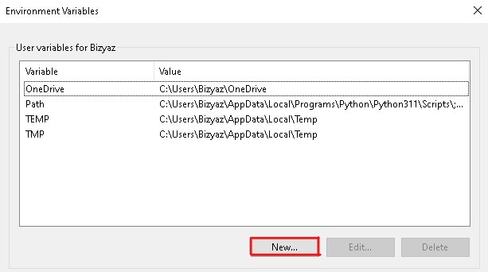
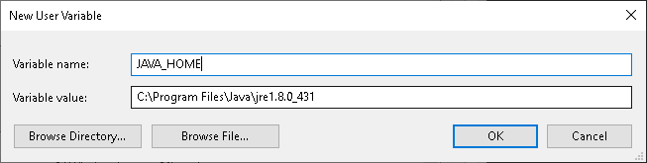
Under User and System Variables, click New.
In the "Variable name" section in the window that opens, type "JAVA_HOME" and add the Java installation path (e.g., C:\Program Files\Java\jdk[version]\bin).

Slide 7
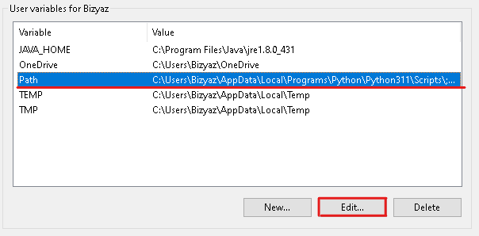
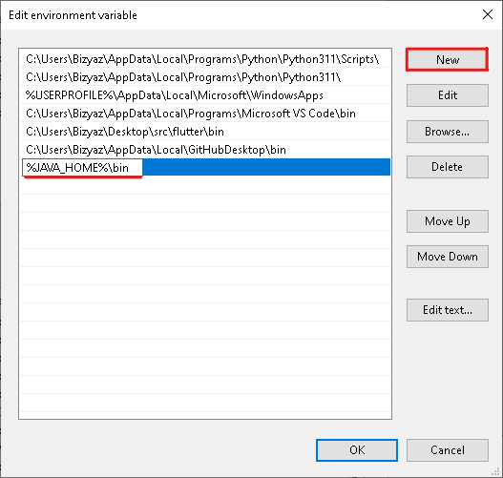
Under User and System Variables, find the "Path" variable and click "Edit".
In the window that opens, click "New" and type %JAVA_HOME%\bin and click ok.

Slide 8
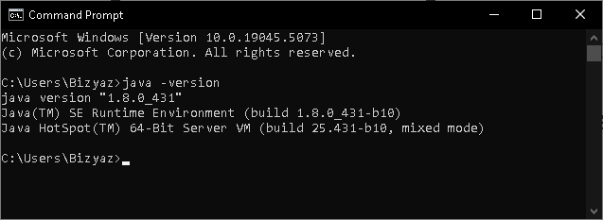
Verifying Java Installation
Open Command Prompt.
Type java -version to check if Java is installed and recognized in the system path.
Ensure the output displays the correct Java version you installed.

Slide 9
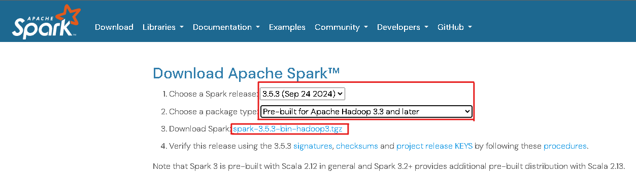
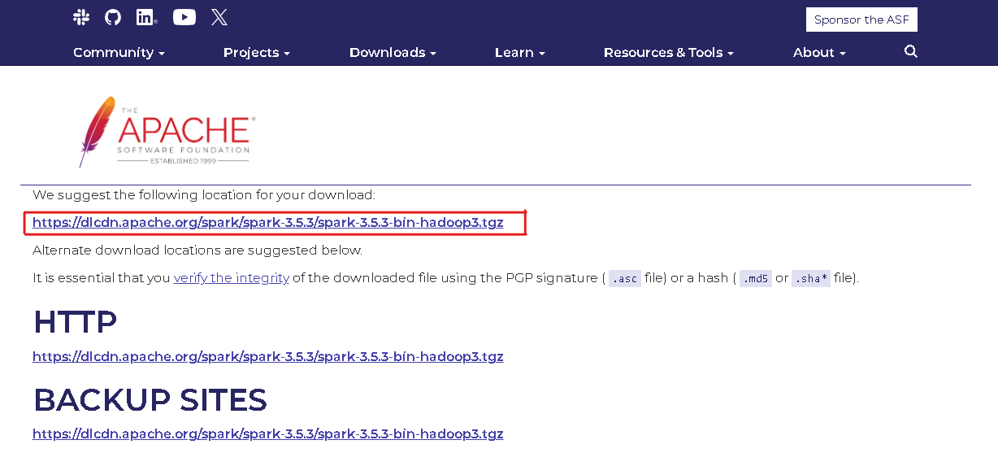
Step 3: Downloading Apache Spark
Go to the official Apache Spark website: https://spark.apache.org/downloads.html
Choose the latest version and select a pre-built package for Hadoop (optional).
Download the Spark tar file (.tgz) for Windows.

Slide 10
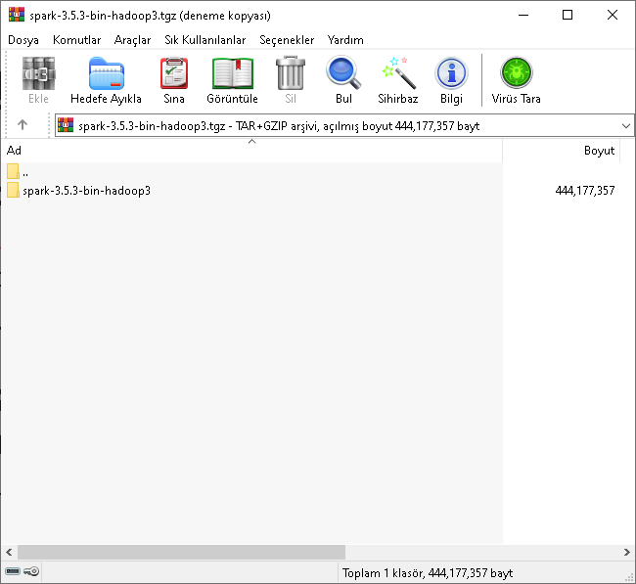
Extracting and Setting Up Spark
Extract the downloaded tar file to a convenient location (e.g., C:\spark).
This folder will contain all Spark binaries and configuration files needed to run Spark locally.

Slide 11
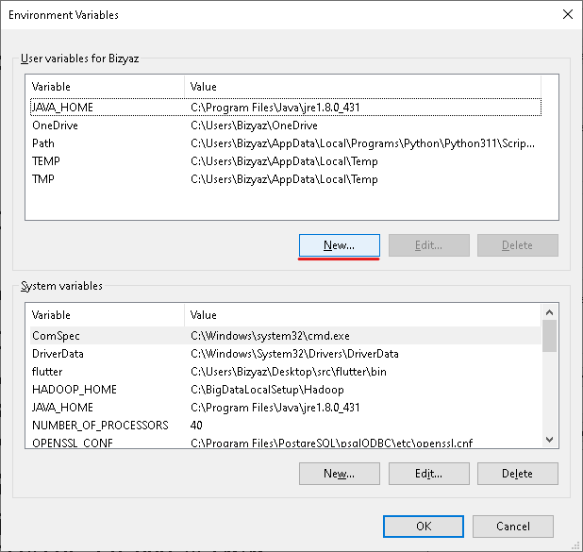
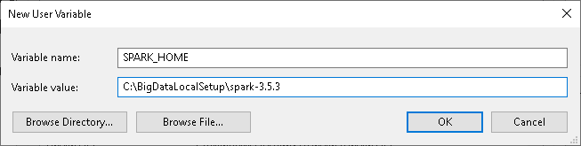
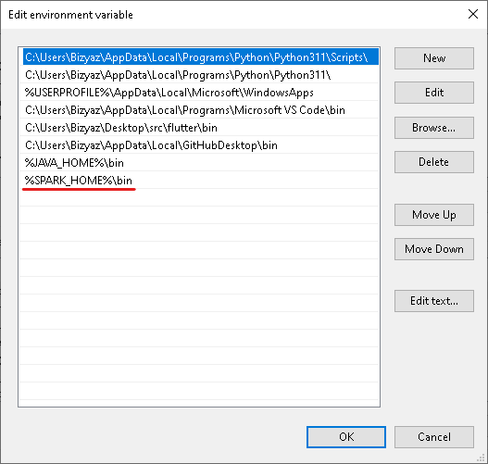
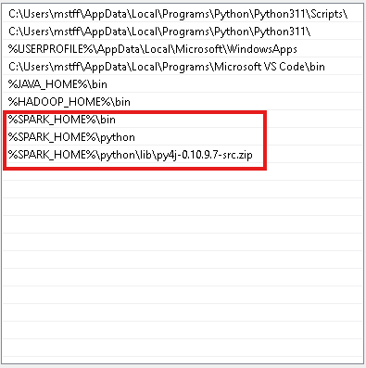
Configuring Environment Variables
Go to System Properties > Environment Variables.
Under System Variables and User Variables, create a new variable:
SPARK_HOME: Set this to the Spark installation path (e.g., C:\spark).
PYSPARK_PYTHON: Set (python)
Add Spark to the Path variable:
Edit the Path variable and add %SPARK_HOME%\bin %SPARK_HOME%\python %SPARK_HOME%\python\lib\py4j-0.10.9.7-src.zip

Slide 12
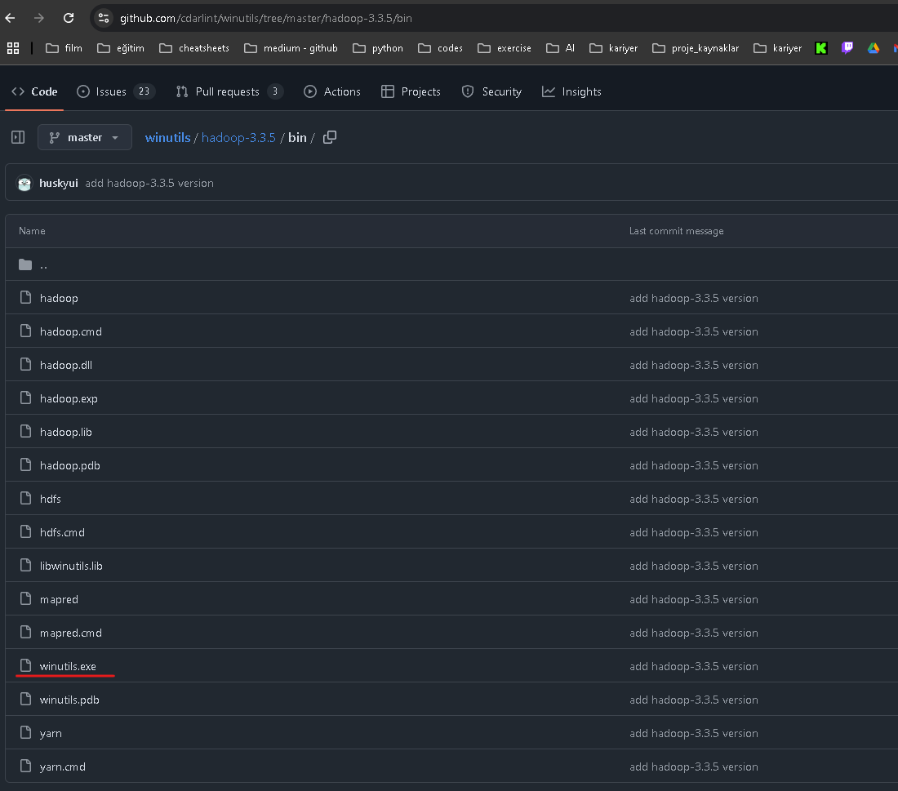
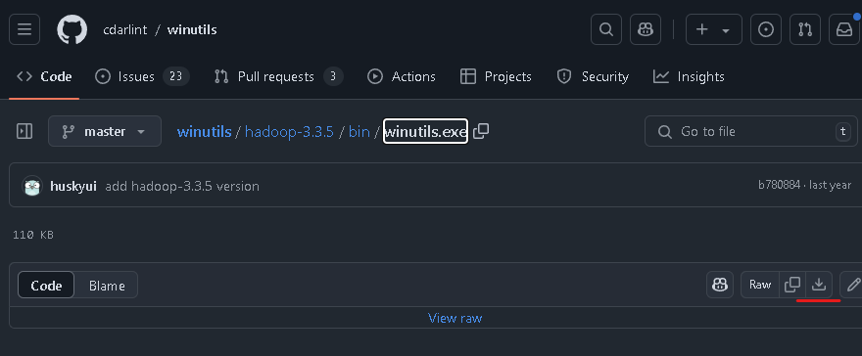
Step 4: Setting Up WinUtils
Navigate to the winutils GitHub repository:
https://github.com/cdarlint/winutils/blob/master/hadoop-3.3.5/bin/winutils.exe
Download the winutils.exe file from the bin directory.
Create a “bin” folder inside the “hadoop” folder.
Copy the downloaded winutils.exe file into the “C:\hadoop\bin” directory.

Slide 13
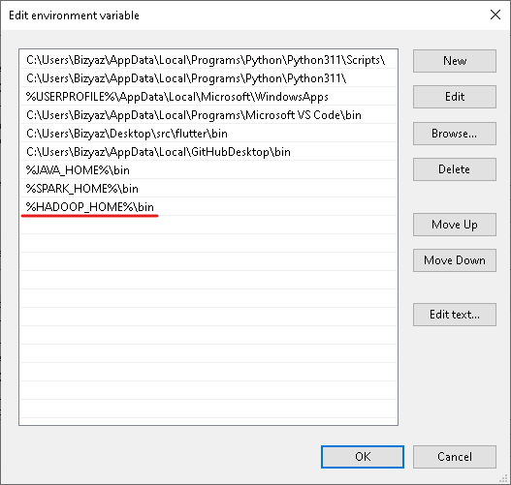
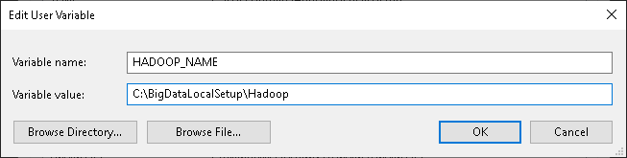
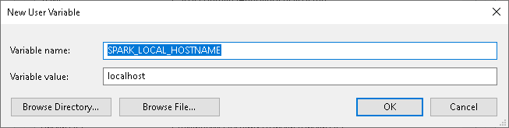
Configuring Environment Variables
Set an environment variable for Hadoop
HADOOP_HOME = C:\DIRECTORY\hadoop.
Add Hadoop to the Path variable:
Edit the Path variable and add %HADOOP_HOME%\bin.
This setup is optional but may help avoid certain permission errors when running Spark on Windows
Additionally: Set an environment variable for Spark SPARK_LOCAL_HOSTNAME = localhost.

Slide 14
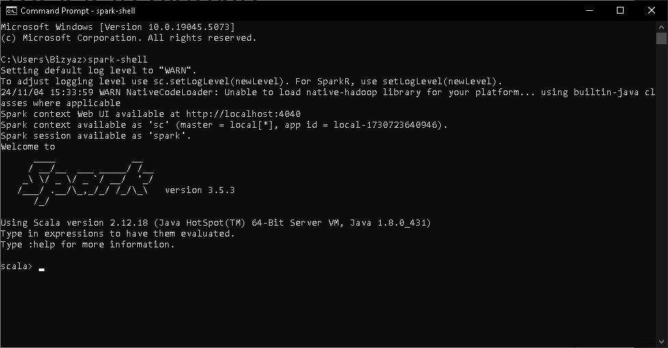
Verifying Spark Installation
Open Command Prompt.
Run the command spark-shell.
If Spark is installed correctly, the Spark shell will launch, and you’ll see the Scala prompt.

Slide 15
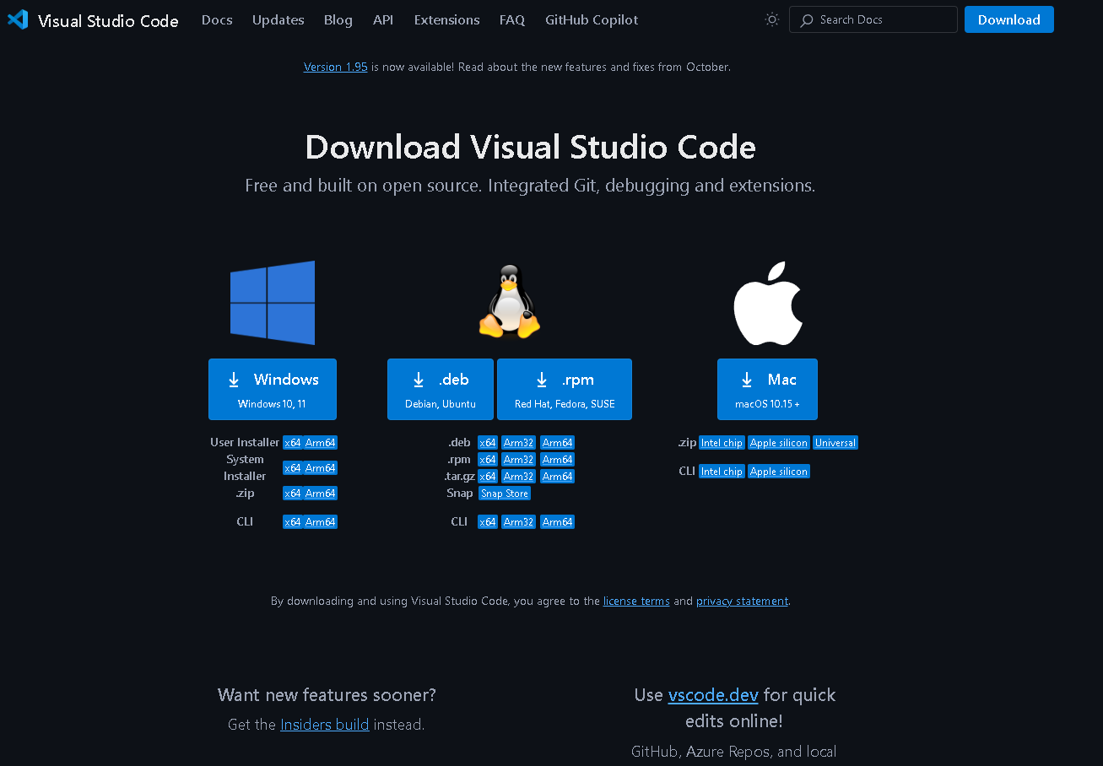
Downloading and Installing Visual Studio Code
Download VS Code from https://code.visualstudio.com/Download.
Run the installer and follow the instructions.
After installation, open VS Code to configure Python and PySpark.

Slide 16
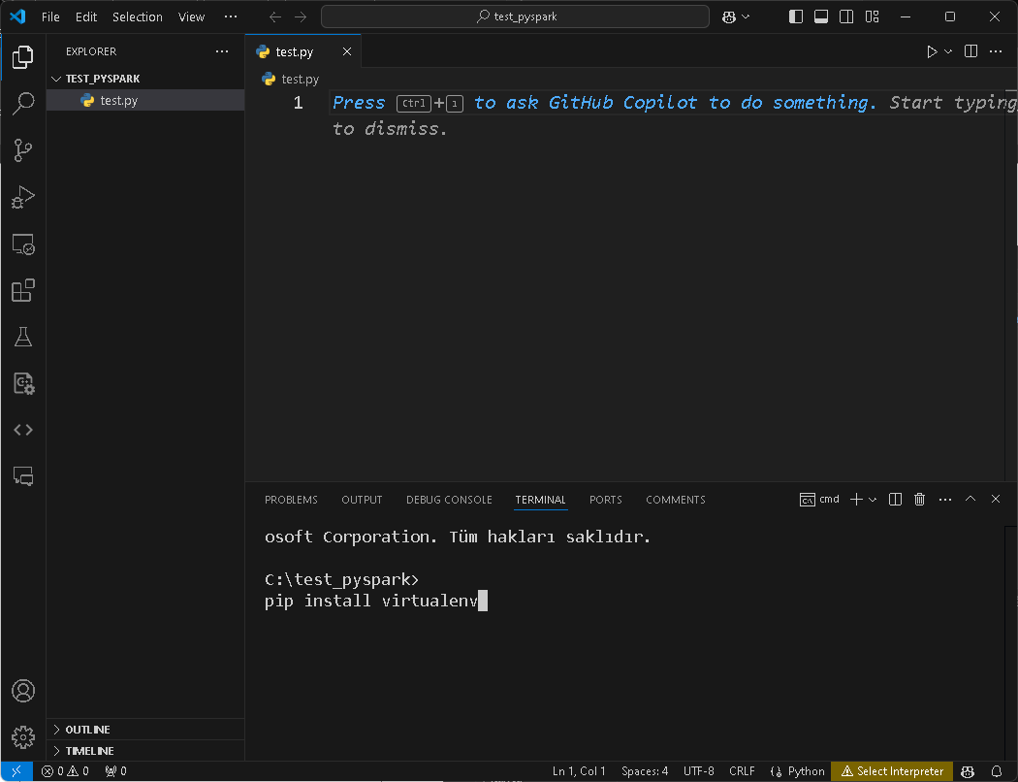
Virtual Environment in VS Code
Create a folder named pyspark on the C drive.
Open this folder in Vscode.
To create a virtual environment, first run the pip install virtualenv command

Slide 17
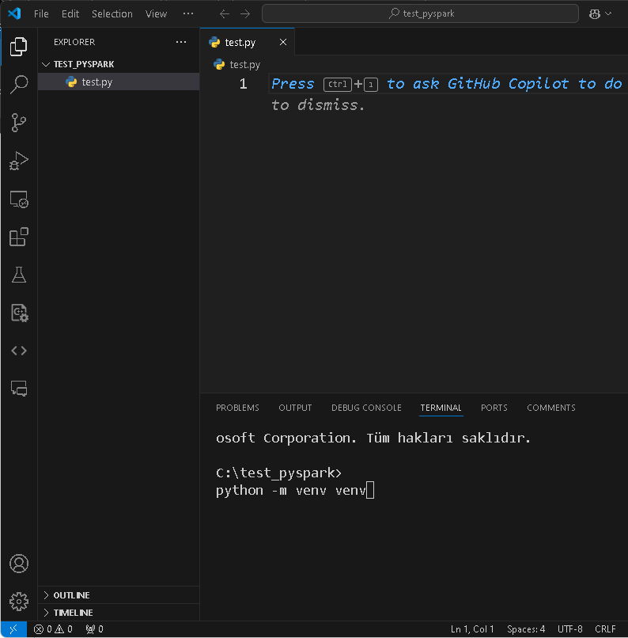
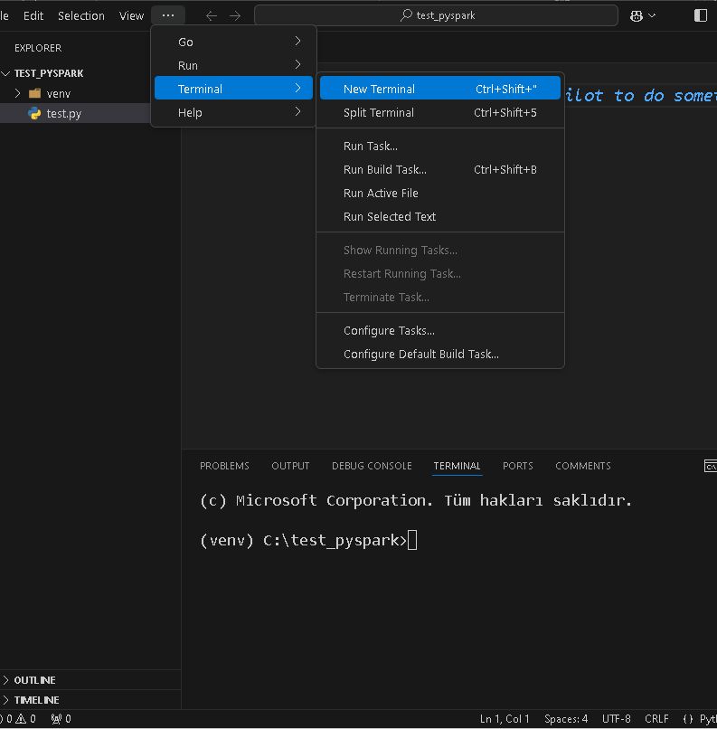
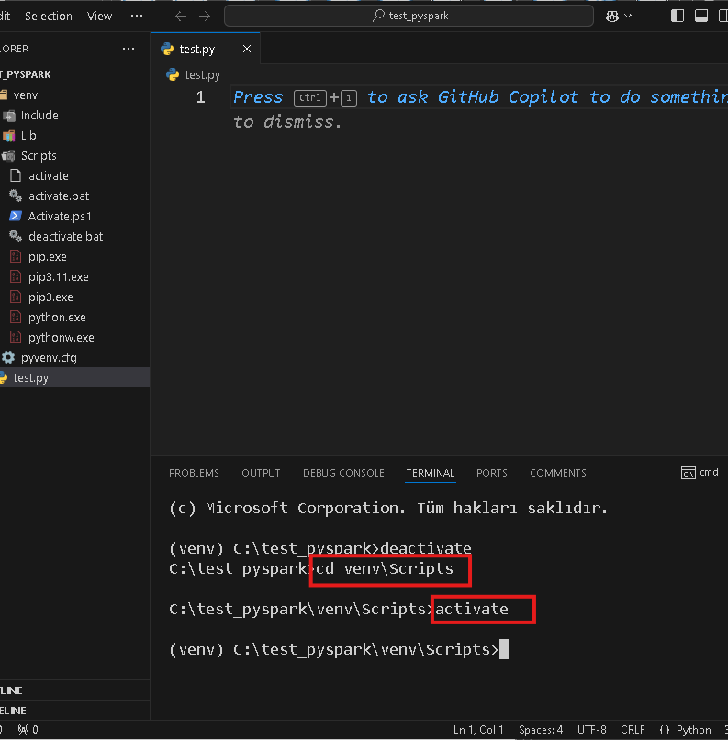
Virtual Environment in VS Code
Kill your terminal and open a terminal again.
If venv is not automatically activated, run the commands
- cd venv\Scripts
- activate

Slide 18
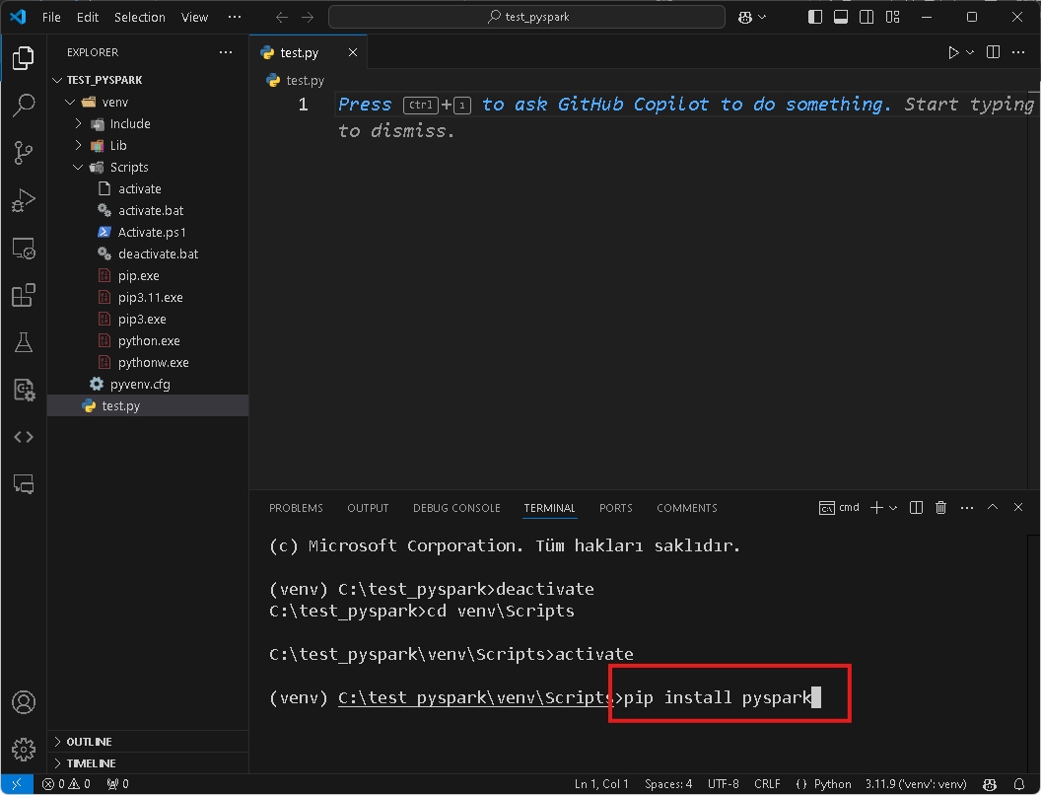
Setting Up PySpark in VS Code
In VS Code, open the terminal.
Run pip install pyspark to install PySpark directly in your Python environment.
This installs PySpark and allows you to import it in your Python scripts.

Slide 19
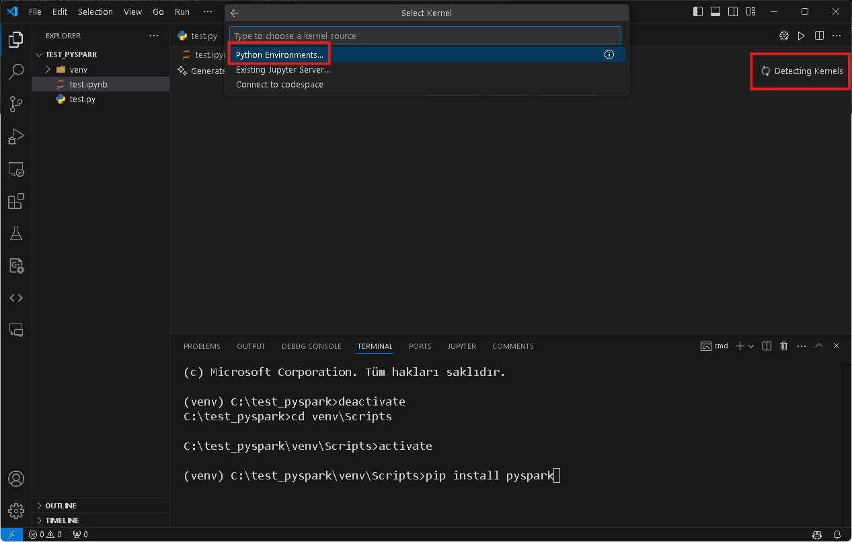
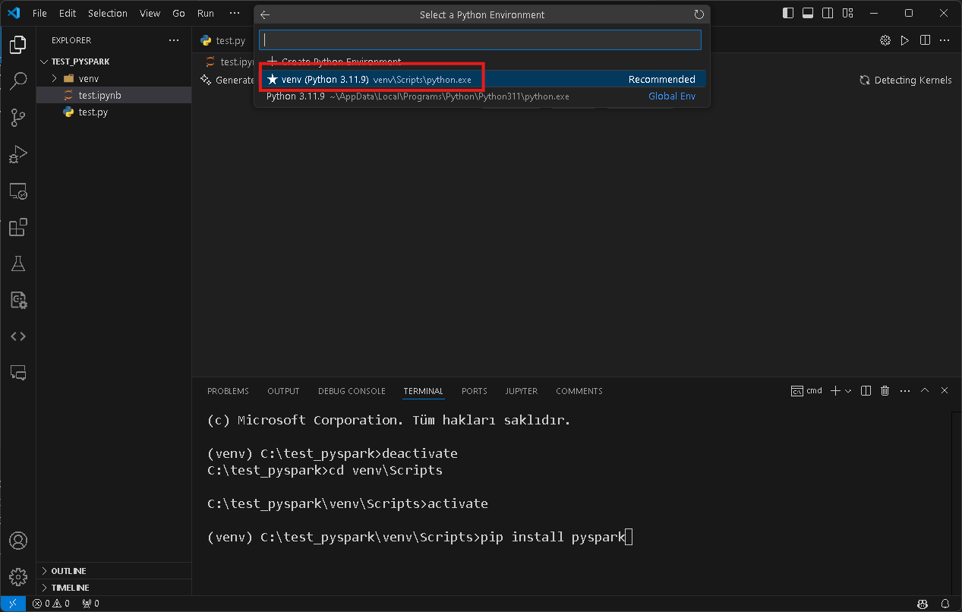
Working in Jupyter Notebook
Create a file with the extension .ipynb.
First select "Detecting Kernels".
Then select "Python Environment".
Then select the venv you created.

Slide 20
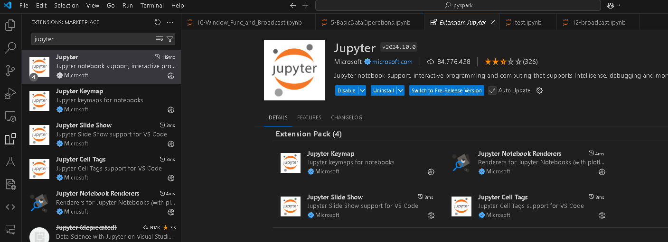
Working in Jupyter Notebook
Add jupyter from vscode extension section

Slide 21
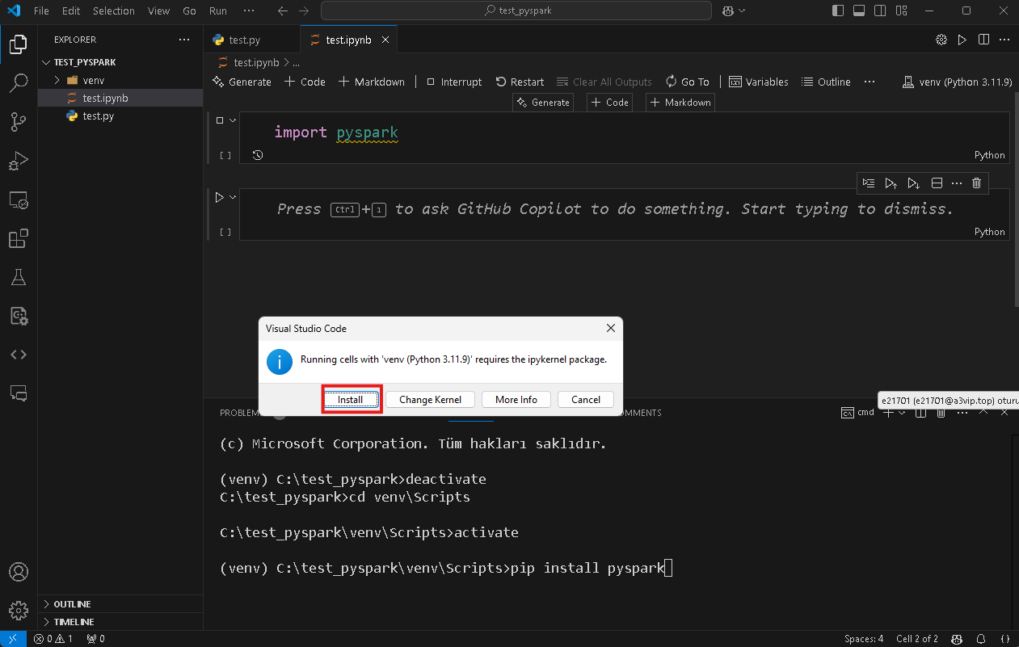
Working in Jupyter Notebook
Type "import pyspark" and run the kernel.
Click "Install" in the kernel warning that appears on the screen.

Slide 22
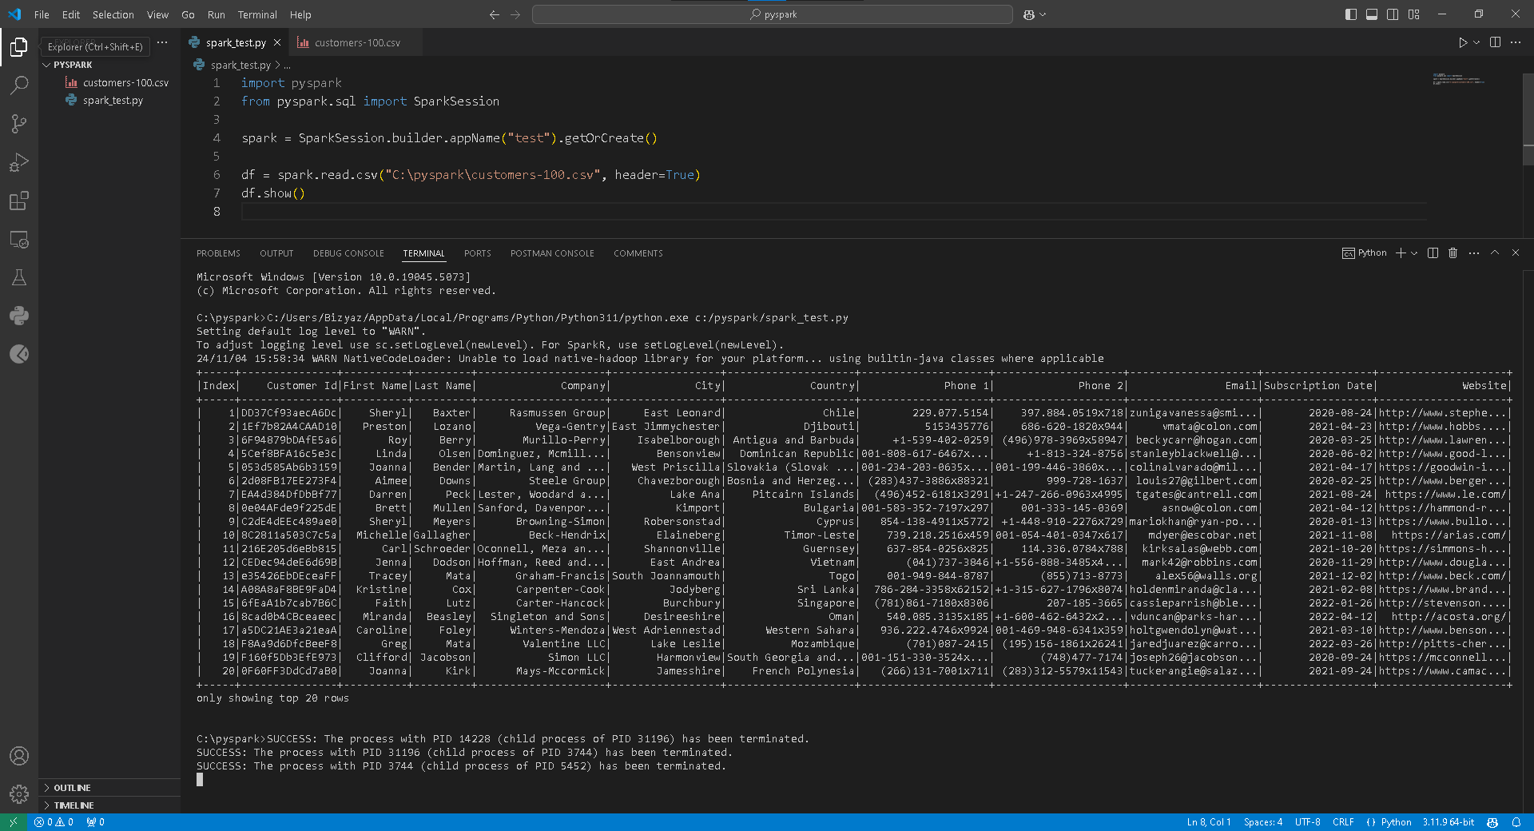
Creating a PySpark Project in VS Code
Open VS Code and create a new folder for your PySpark project.
Inside this folder, create a new Python file (e.g., example.py).
Start by importing PySpark:
from pyspark.sql import SparkSession.
Write a simple csv reader and verify that pyspark works.

Slide 23
Resources
https://www.python.org/downloads/
https://www.java.com/download/ie_manual.jsp
https://spark.apache.org/downloads.html
https://github.com/cdarlint/winutils/blob/master/hadoop-3.3.5/bin/winutils.exe
https://code.visualstudio.com/download

Slide 24

THANK YOU

